Slide 1


AI-BASED EVENT
PLANNER & SCHEDULER
Intelligent Platform for Automated Management
Submitted by: Palak Singla

Slide 2
Introduction
• A comprehensive web platform connecting users with event planners.
• Integrates Google Gemini AI to provide budget predictions and recommendations.
• Automates the entire workflow: Booking, Payments, and Notifications.
• Solves the complexity of manual coordination and vendor tracking.

Slide 3
System Architecture
Google Gemini
(AI Agent)
React Frontend
(UI Layer)
Spring Boot
(Business Logic)
Razorpay
(Payment
Gateway)
MySQL
(Database)

Slide 4
Technology Stack
Frontend
React.js, Tailwind CSS
Backend
Spring Boot (Java), REST API
Database
MySQL, Spring Data JPA
AI Service
Google Gemini API

Slide 5
User Dashboard
Discover Planners
Browse verified planners with filters for location & price.
AI Budget Predictor
Get instant cost estimates based on guest count.
Book & Enquire
Direct booking system with status tracking.
History & Payments
View past events and download receipts.

Slide 6
Admin Dashboard
Platform Analytics
Visual charts for revenue, users, and booking stats.
User Management
Approve/Reject planners and manage user access.
Financial Oversight
Monitor Razorpay transactions in real-time.
Automated Workflows
Auto-send email reminders and notifications.

Slide 7
Payment Process
01
02
03
04
Selection
Choose Planner
Booking
Confirm Details
Payment
Razorpay Secure
Success
DB Update

Slide 8
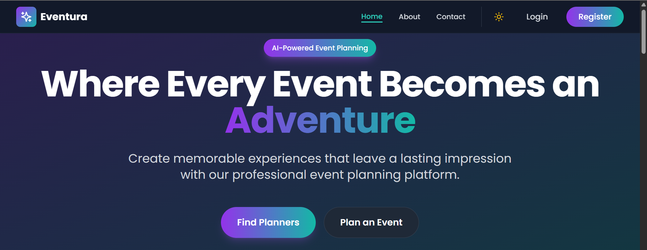
Project Screenshots
Home page showing about the website

Slide 9
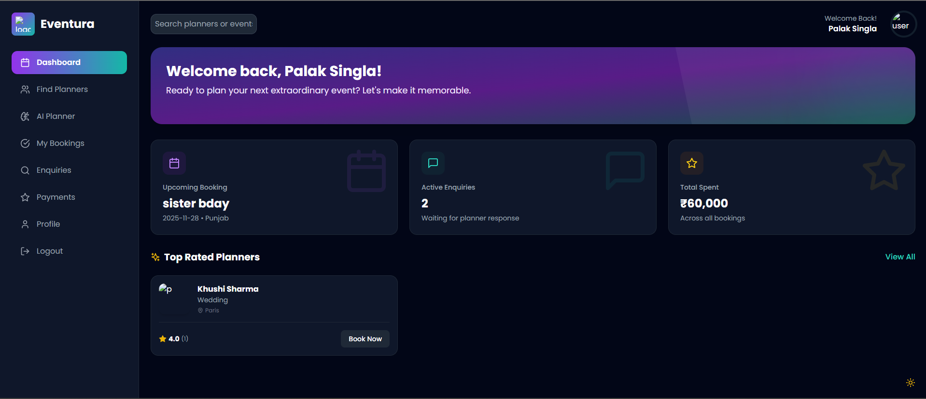
Project Screenshots
User Dashboard where users can interact with different functionalities

Slide 10
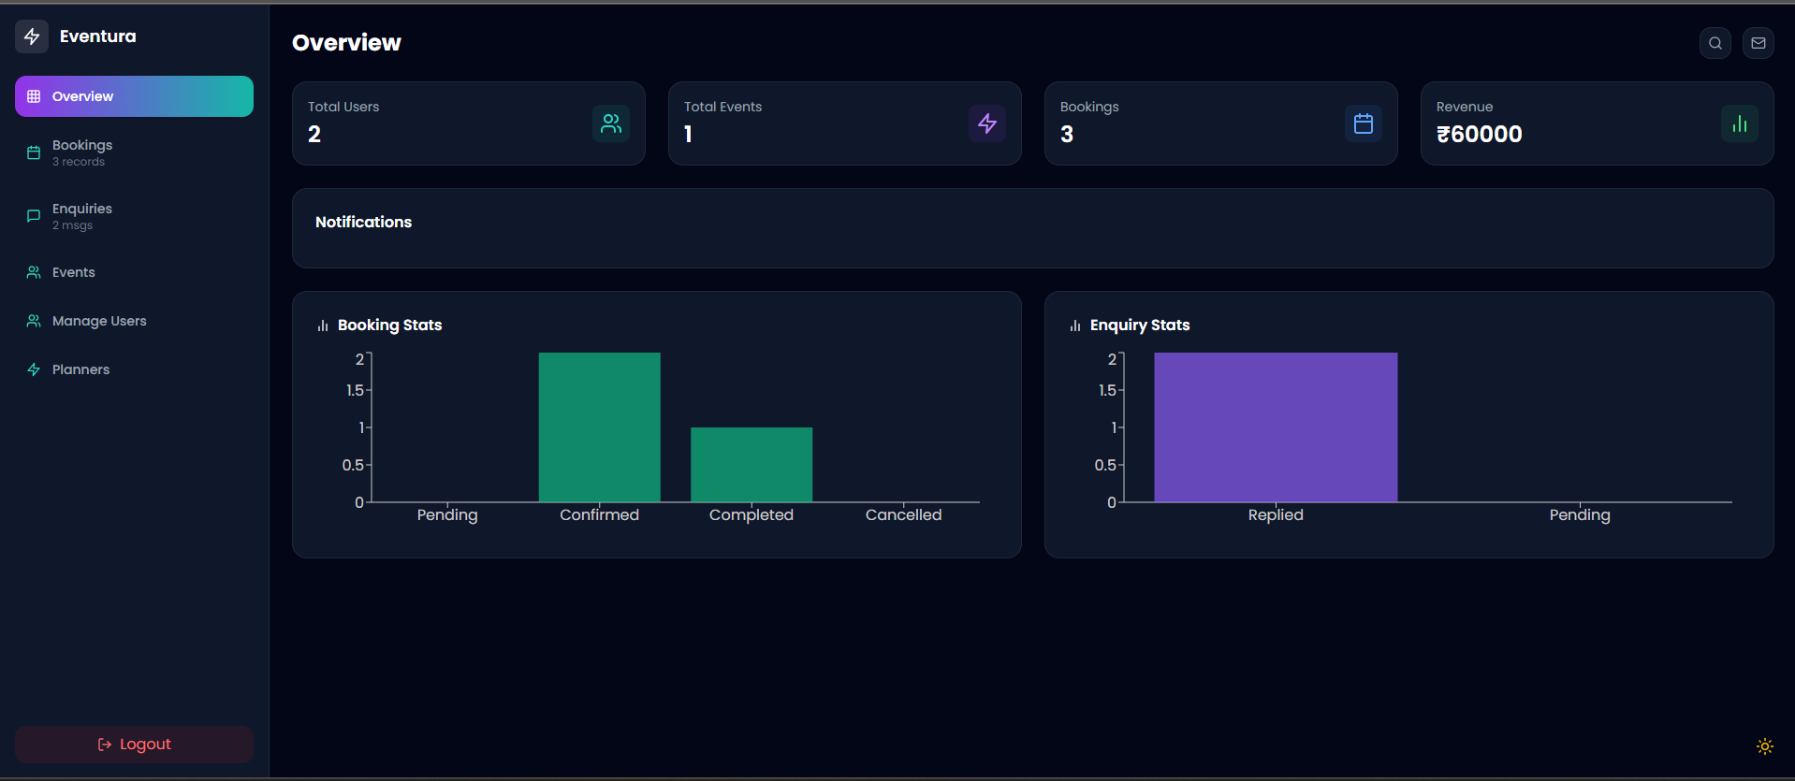
Project Screenshots
Admin Dashboard where admin can manage the website efficiently

Slide 11
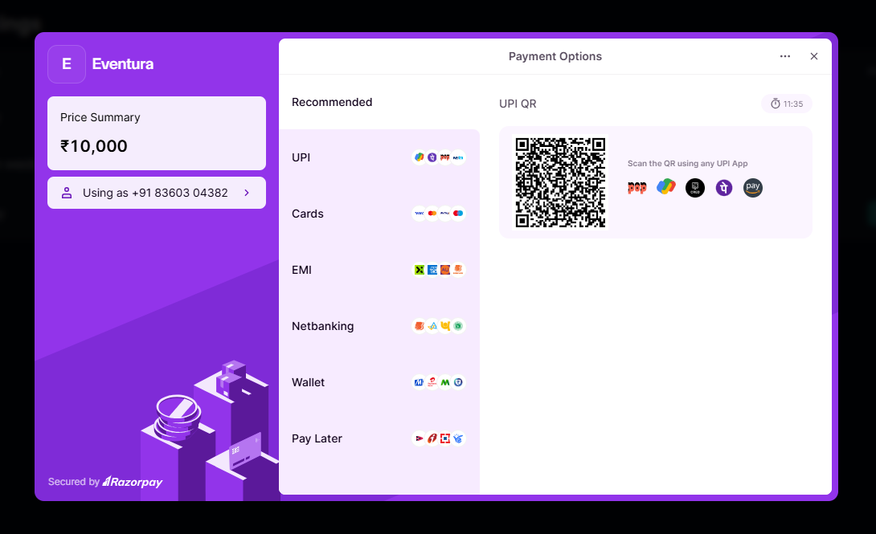
Project Screenshots
Razor Pay Payment Gateway where users can pay for their confirmed bookings through various payment options

Slide 12
THANK YOU

